Slide 1
Beni Architettonici
Classificatore Multilabel Disegni
Fabio D’Amore

Slide 2
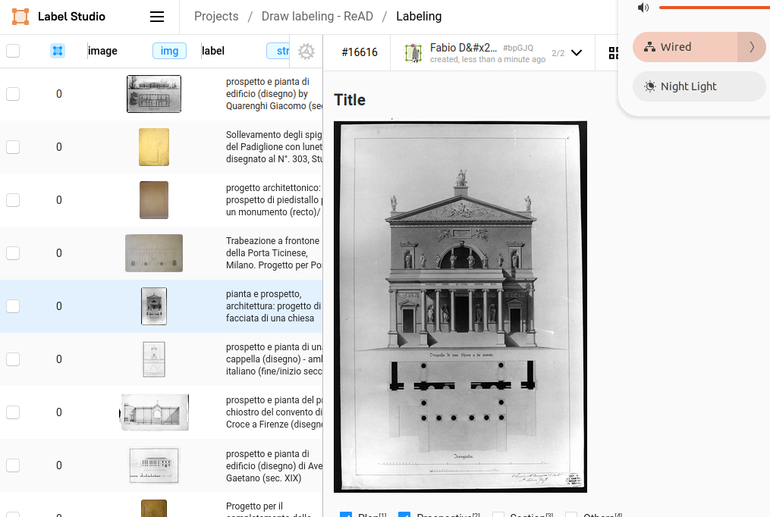
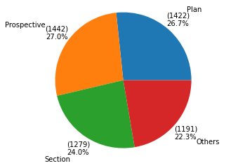
Data from dati.cultura.gov
Downloaded 3968 random draw, labeled by description and stored in Label Studio:
The training set is augmented but test set isn’t (to test the model in ‘real’ environment conditions).
Endpoint: https://dati.cultura.gov.it/sparql
Training set 3175
Validation set 793 (20%)
Multi-label means this image could contains Elevation and plan

Slide 3
Shared Label Studio installation
Activities:
VM requested to ISTC Internal Services
Label Studio installation and configuration
Initial data load (images and related labels)
Internet proxy configuration
SSL self generated certificate installation
Review data set labels (by domain experts)

Slide 4
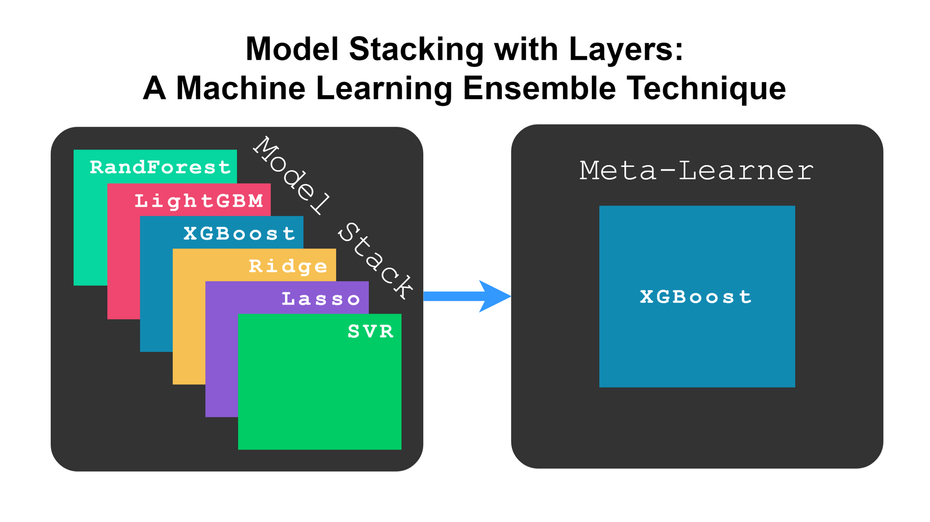
Ensemble learning
Bagging stands for bootstrap aggregation. It combines multiple learners in a way to reduce the variance of estimates: train M different trees on different random subsets of the data and perform voting for final prediction. I.e. Random Forest is a bagging method.
Boosting algorithms are a set of the low accurate classifier to create a highly accurate classifier. Boosting algorithm can track the model who failed the accurate prediction and are less affected by the overfitting problem. I.e.
AdaBoost (Adaptive Boosting)
Gradient Tree Boosting
XGBoost
Stacking(or stacked generalization) is an ensemble learning technique that combines multiple base classification models predictions into a new data set. This new data are treated as the input data for another classifier. This final (Meta) classifier employed to solve this problem.
*https://www.datacamp.com/tutorial/adaboost-classifier-python
*https://developer.ibm.com/articles/stack-machine-learning-models-get-better-results/

Slide 5
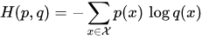
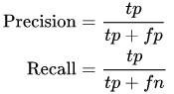
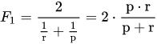
Loss and Metrics for multi class classification
Loss categorical crossentropy (deep learning models)
Higher precision means that an algorithm returns more relevant results than irrelevant ones, and high recall means that an algorithm returns most of the relevant results (whether or not irrelevant ones are also returned).
(from Wikipedia)
Precision can be seen as a measure of quality
Metric f1 score
Recall as a measure of quantity (sensitivity)
The F1 score is the harmonic mean of the precision and recall.
Accuracy = T P + T N
T P + T N + F P + F N
Accuracy is the probability that the model prediction is correct.

Slide 6
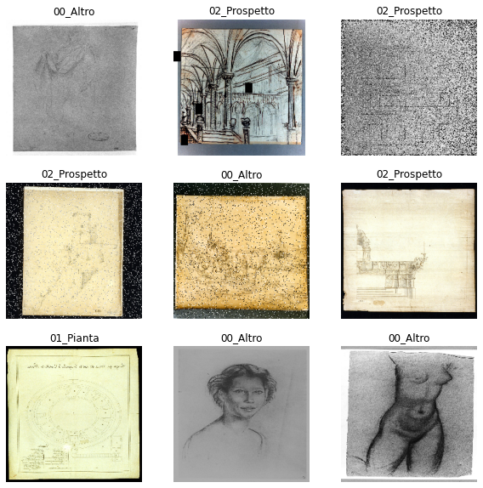
Model
224x224x3
RGB images
VGG16 transfer learning (CNN already trained)
Optional use of PCA to compress features
Train different classificators
Select the best classificator
Vgg16
4096
Latent space
PCA (98%)
574
Compressed latent space
Keras
RandomF
SVM
NeuralN
…………….
Selection of the best classifier
P as plan
E as elevation
S as Section
O as Other
P. | E. | S. | O.
Labels

Slide 7
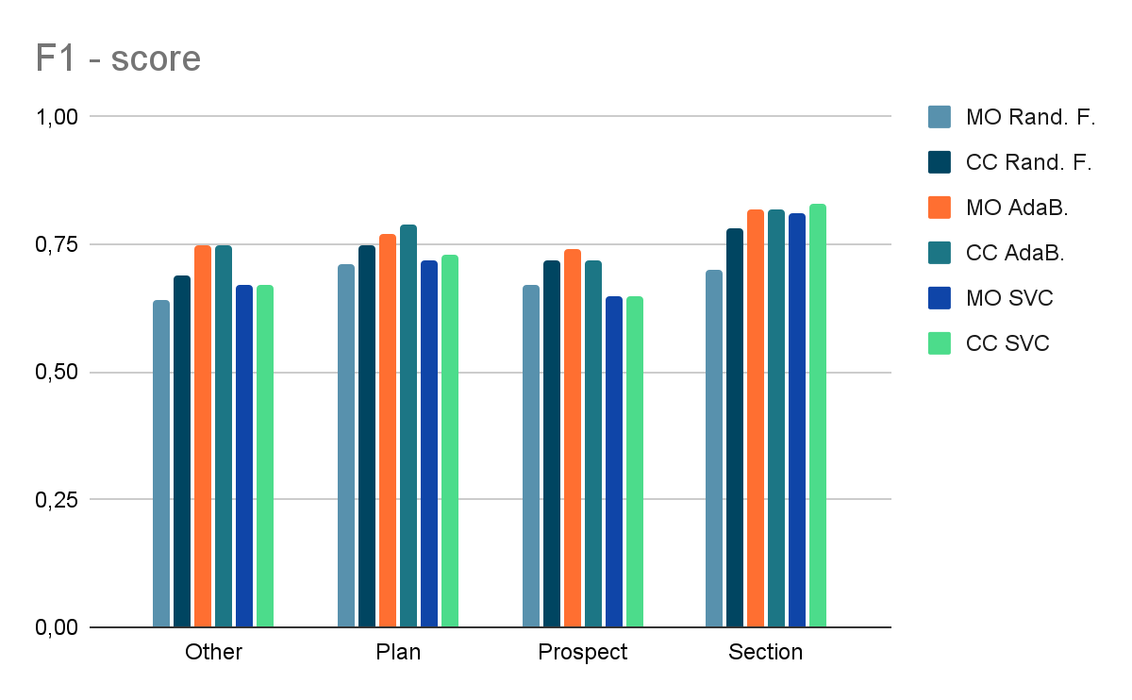
Keras Multilabel API
MultiOutputClassifier (MO)
Multi target classification.
This strategy consists of fitting one classifier per target.
ClassifierChain (CC)
A multi-label model that arranges binary classifiers into a chain.
Each model makes a prediction in the order specified by the chain using all of the available features provided to the model plus the predictions of models that are earlier in the chain.
Out of the box Keras Multilabel classifier don't perform very well, one vs others strategy will be investigated.

Slide 8
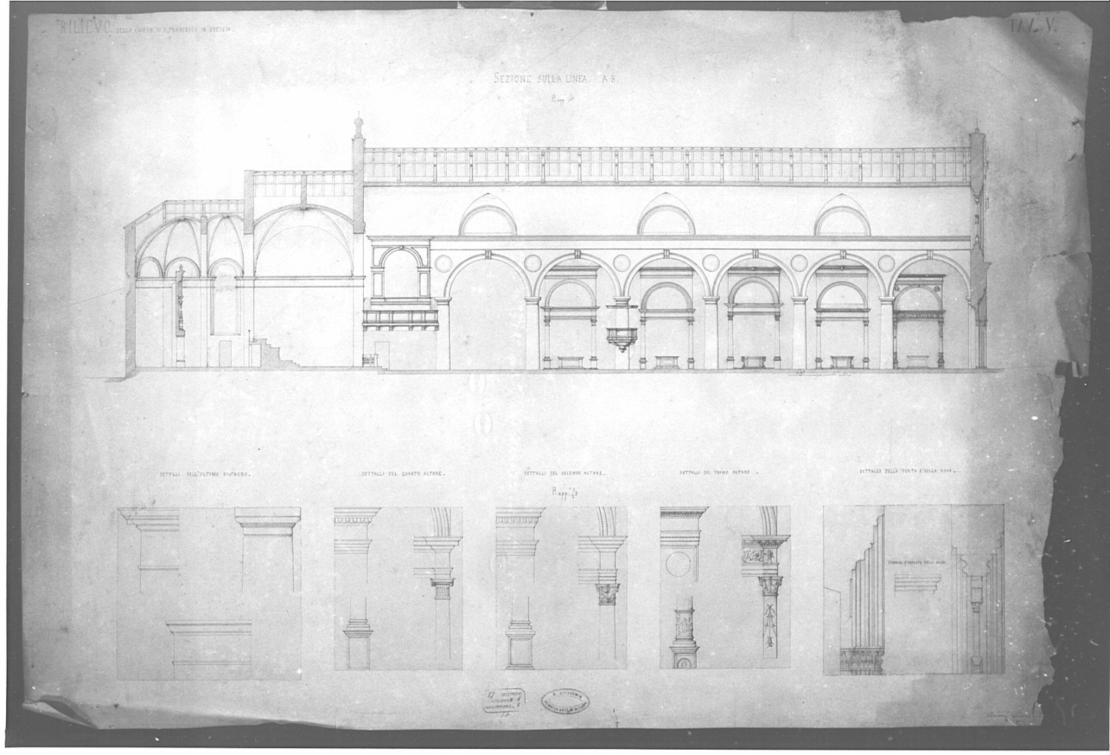
Use 4 binary classifiers (one class vs others)
Vgg16 latent space comp.
Model (4 binary classifiers)
Elevation
vs
All Others
Plan
vs
All Others
Section
vs
All Others
Others
vs
All Others
P as plan
E as elevation
S as Section
O as Other
P. | E. | S. | O.
First step is to select best binary classifier between: Random Forest, XGBoost, LightGBM…ecc.

Slide 9
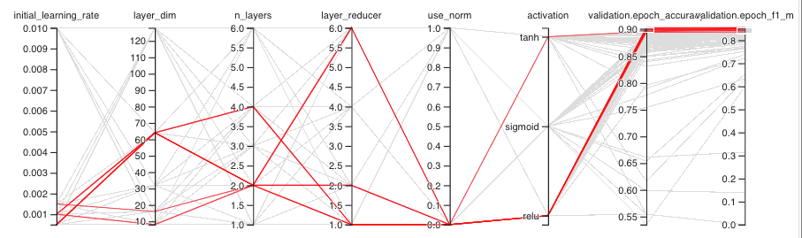
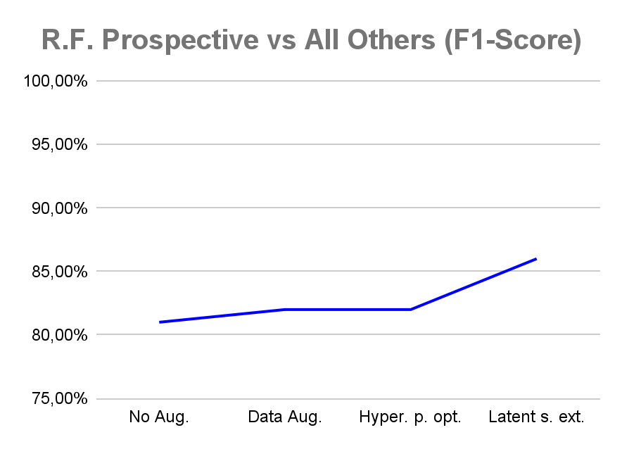
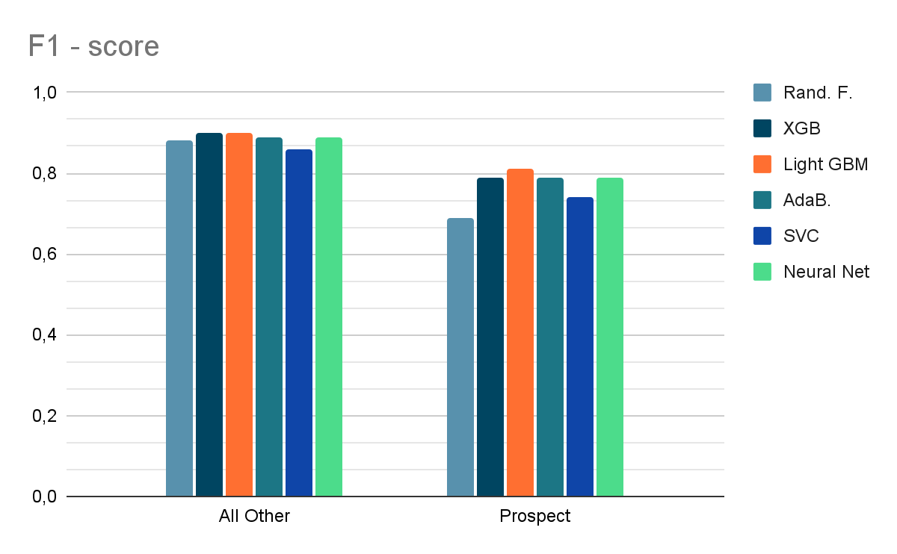
Selecting best classifier
Every binary classifier has hiper parameter optimized (grid search)
Performance are analyzed in details (also fails analysis)
Finally binary classifier are compared and the best was selected

Slide 10
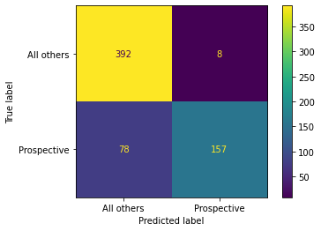
Elevation vs All others (Random Forest binary classifier)
Classification Report
precision recall f1-score support
All others 0.83 0.98 0.90 400
Elevation 0.95 0.67 0.79 235
accuracy 0.86 635
macro avg 0.89 0.82 0.84 635
weighted avg 0.88 0.86 0.86 635
Using extended latent space increase the performance (no PCA applied)

Slide 11
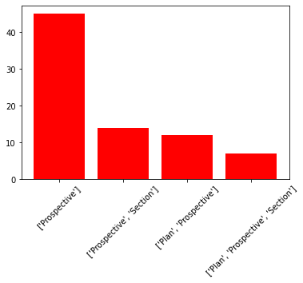
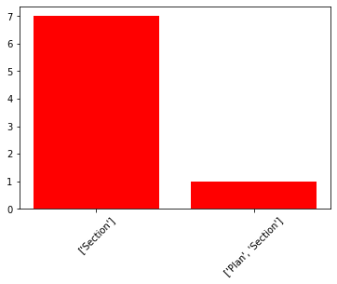
Elevation vs All others (R.F.), test set fails analisys
Model classify 78 images as "All Others" but are:
Model classify 8 images as "Elevation" but are:

Slide 12
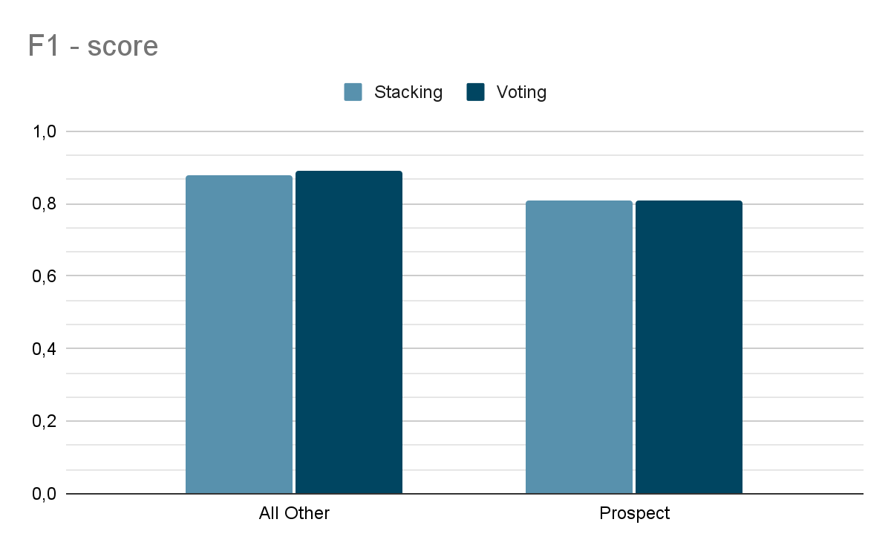
Binary Classifier comparison on Elevation vs All others
Ensemble learning performed on all the previous learner using stacking and voting algorithm, but is doesn't enhance the performance.
All classifier has hyper parameter tuned.

Slide 13
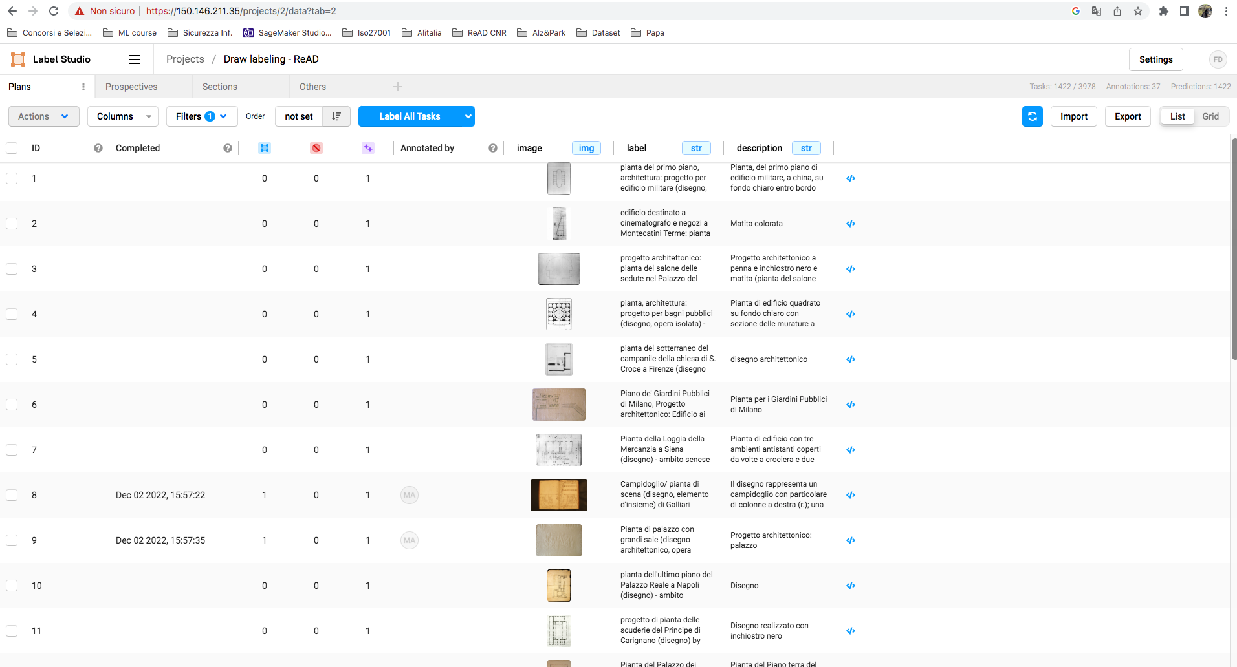
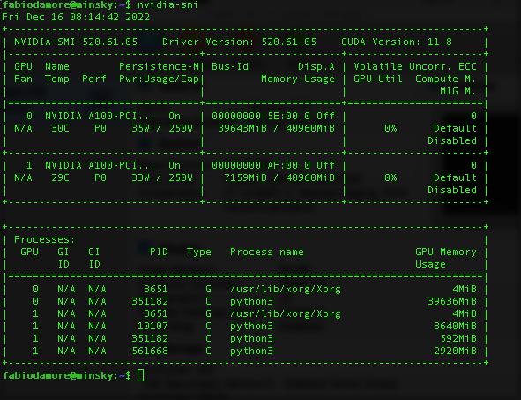
Performance check
Model do not perform very well so we decide to:
Increase and clean dataset using
shared Label Studio installation
Optimize models hyper parameters using powerful hardware
in order to extend hyper parameter space
and increase models performance.

Slide 14
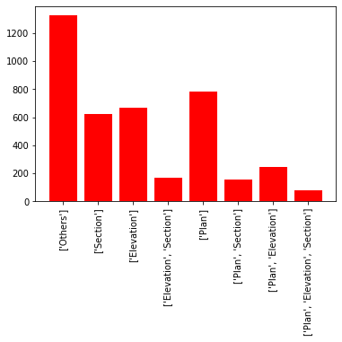
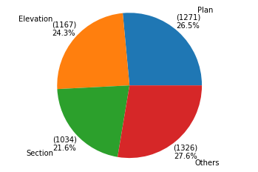
Dataset
Added 1600 images
Cleared duplicates
Tot images 4068

Slide 15
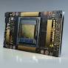
Using powerful hardware
Activities:
Check for GPUs already present in CNR (2 x nvidia A100 with 40Gb of RAM)
Configure a Container (Docker) to run code on GPUs
Review python code used for hyper parameter optimization
Run scripts and analyze results
the target is to explore as much as possible the hyper param space to find models optimal configuration.

Slide 16
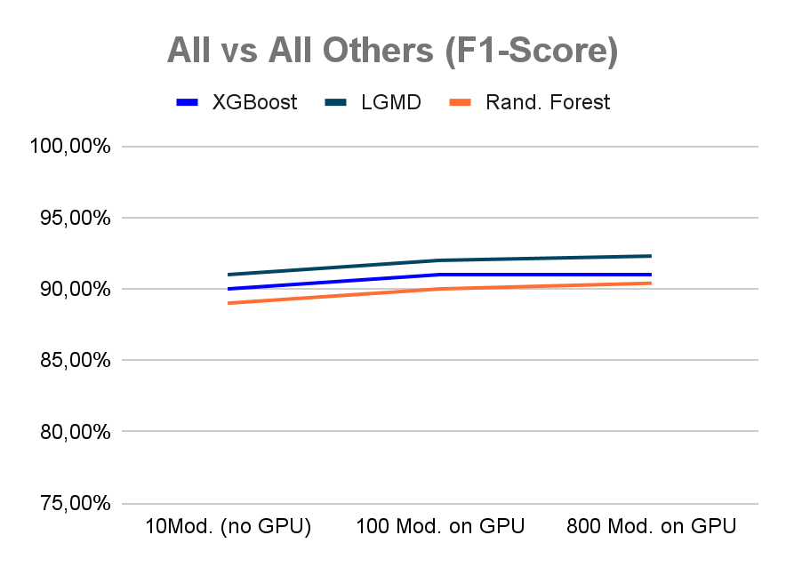
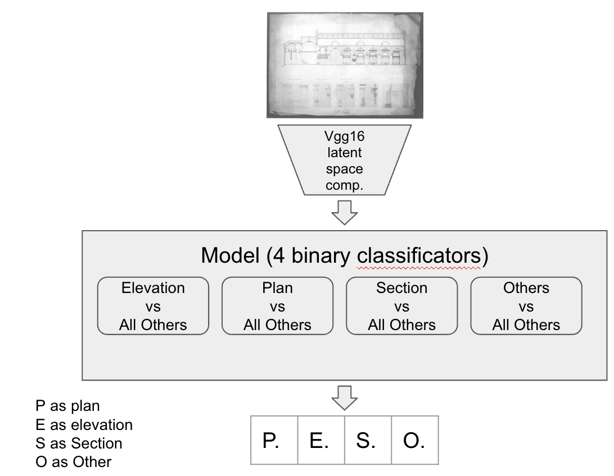
Hyper param. optimization results
All vs 'Section/Elevation/Plan' (F1-Score)
Here results of optimization of the most performing models.
LGMB is the winner.
(4 LGMB bin. classifiers)

Slide 17
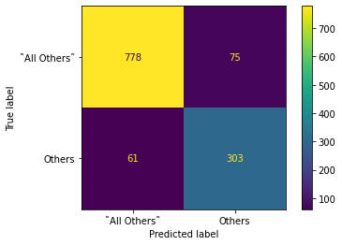
Others VS 'Section/Elevation/Plan'
LGBMClassifier Accuracy: 0.8882497945768283
Classification Report
precision recall f1-score support
˜All Others˜ 0.93 0.91 0.92 853
Others 0.80 0.83 0.82 364
accuracy 0.89 1217
macro avg 0.86 0.87 0.87 1217
weighted avg 0.89 0.89 0.89 1217

Slide 18
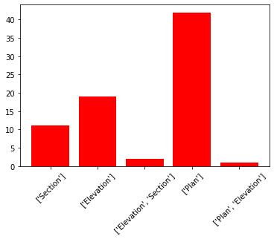
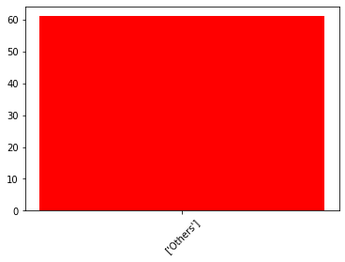
Others VS 'Section/Elevation/Plan'
LGBMClassifier Accuracy: 0.8882497945768283
( Model Others ) - 75 classified as Others but are:
( Model Others ) - 61 classified as 'Section/Elevation/Plan' but are:

Slide 19
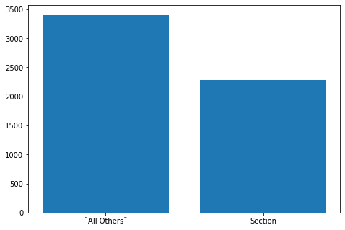
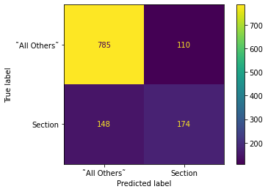
Section VS All Others
LGBMClassifier Accuracy: 0.7880032867707477
Classification Report
precision recall f1-score support
˜All Others˜ 0.84 0.88 0.86 895
Section 0.61 0.54 0.57 322
accuracy 0.79 1217
macro avg 0.73 0.71 0.72 1217
weighted avg 0.78 0.79 0.78 1217

Slide 20
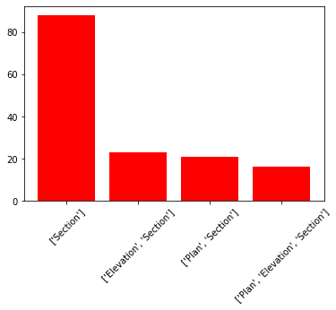
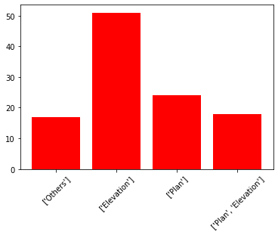
Section VS All Others
LGBMClassifier Accuracy: 0.7880032867707477
( Model Section ) - 148 classified as ˜All Others˜ but are:
( Model Section ) - 110 classified as Section but are:

Slide 21
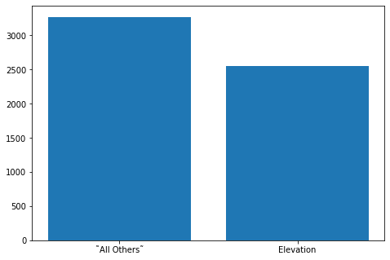
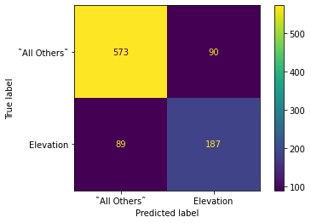
Elevations VS All Others
LGBMClassifier Accuracy: 0.8093716719914803
Train dataset balance
Classification Report
precision recall f1-score support
˜ All Others˜ 0.87 0.86 0.86 663
Elevation 0.68 0.68 0.68 276
accuracy 0.81 939
macro avg 0.77 0.77 0.77 939
weighted avg 0.81 0.81 0.81 939

Slide 22
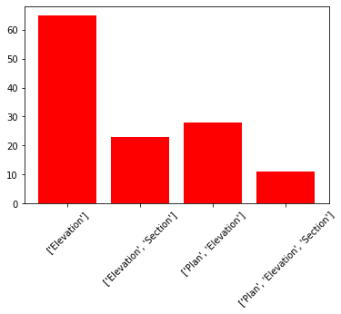
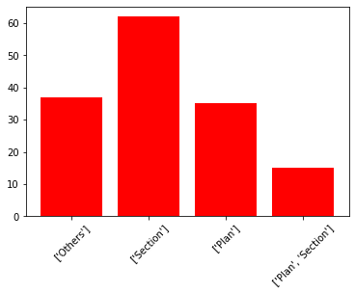
Elevations VS All Others
LGBMClassifier Accuracy: 0.8093716719914803
( Model Elevation ) - 127 classified as ˜All Others˜ but are:
( Model Elevation ) - 149 classified as Elevation but are:

Slide 23
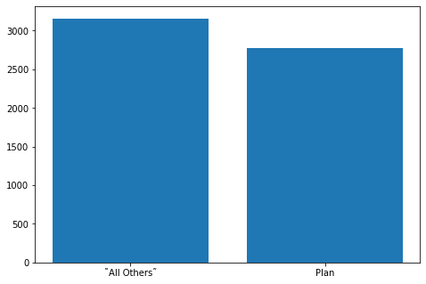

Plans VS All Others
Train dataset balance
LGBMClassifier Accuracy: 0.8168264110756124
Classification Report
precision recall f1-score support
˜ All Others˜ 0.86 0.89 0.88 685
Plan 0.68 0.62 0.65 254
accuracy 0.82 939
macro avg 0.77 0.75 0.76 939
weighted avg 0.81 0.82 0.81 939

Slide 24
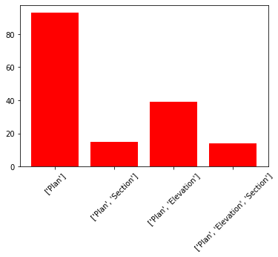
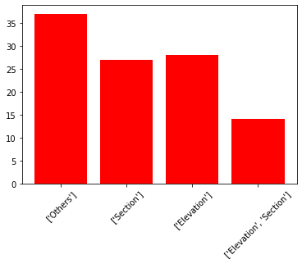
Plans VS All Others
LGBMClassifier Accuracy: 0.8168264110756124
( Model Plan ) - 161 classified as ˜All Others˜ but are:
( Model Plan ) - 106 classified as Plan but are:

Slide 25
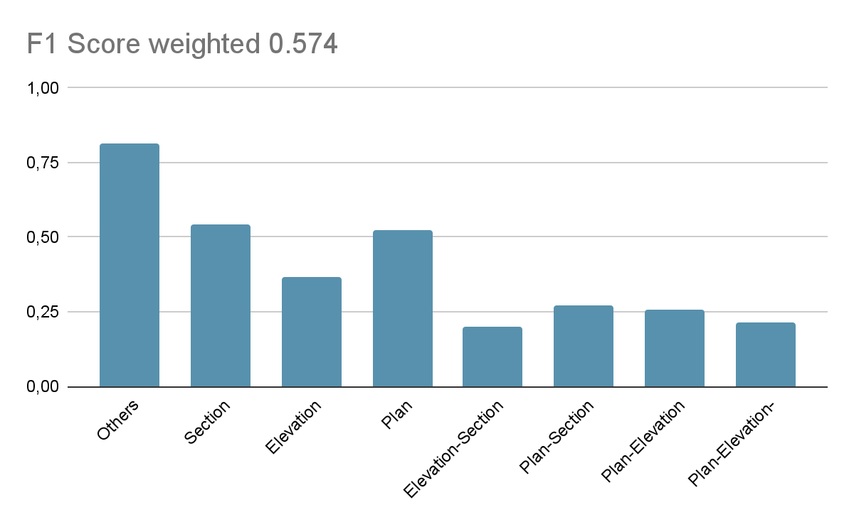
Final result (4 LGMB Parallel/binary classifiers)
(4 LGMB bin. classifiers)
precision recall f1-score support
['Others'] 0.885 0.753 0.814 441.000
['Section'] 0.628 0.479 0.544 169.000
['Elevation'] 0.456 0.305 0.365 118.000
['Elevation', 'Section'] 0.169 0.244 0.200 45.000
['Plan'] 0.556 0.498 0.525 201.000
['Plan', 'Section'] 0.259 0.286 0.272 49.000
['Plan', 'Elevation'] 0.275 0.244 0.259 78.000
['Plan', 'Elevation', 'Section'] 0.207 0.222 0.214 27.000
micro avg 0.581 0.531 0.555 1128.000
macro avg 0.229 0.202 0.213 1128.000
weighted avg 0.629 0.531 0.574 1128.000
Tot errate 529 su 1128 (46.9%)

Slide 26
Use Cascade 4 binary classifiers (one class vs others)
Since 'Others' exclude the other classes and is the best classifiers, one strategy could be cascade topology.
Vgg16 latent space comp.
Model (4 LGMB binary classif.)
Others
vs
pl/sec/elev
0
Plan
vs
All Others
Section
vs
All Others
Elevation
vs
All Others
P as plan
E as elevation
S as Section
O as Other
P. | E. | S. | O.

Slide 27
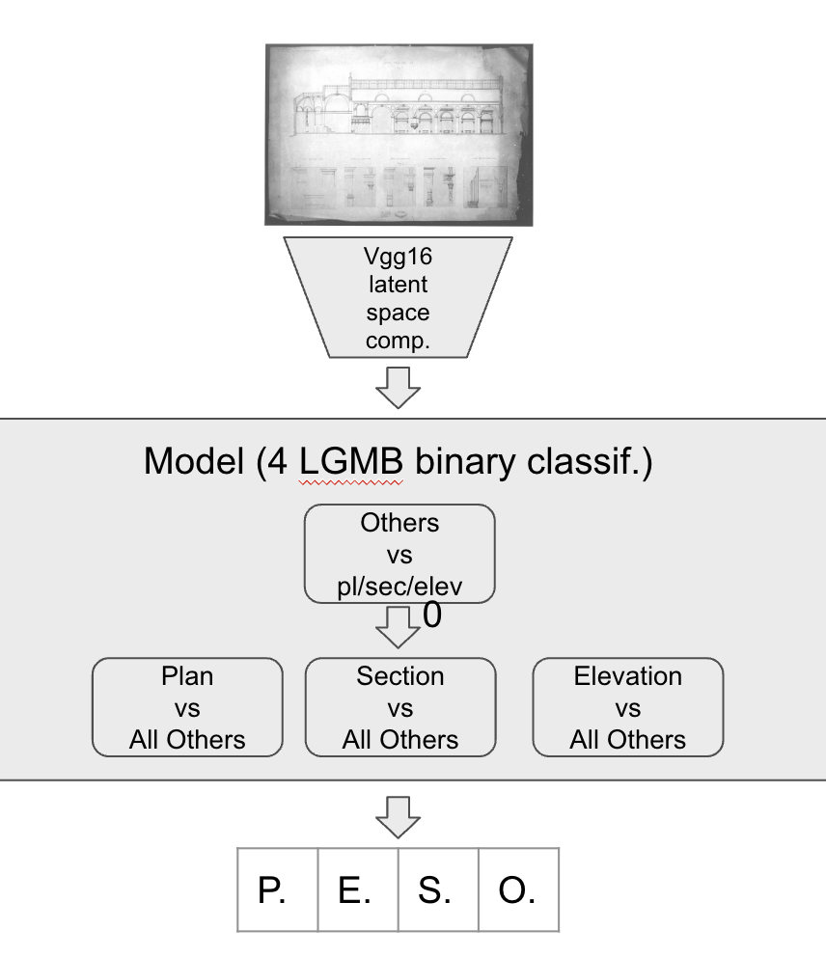

Final result (4 LGMB Cascade/binary classifiers)
precision recall f1-score support
['Others'] 0.826 0.798 0.812 441.000
['Section'] 0.628 0.479 0.544 169.000
['Elevation'] 0.456 0.305 0.365 118.000
['Elevation', 'Section'] 0.169 0.244 0.200 45.000
['Plan'] 0.556 0.498 0.525 201.000
['Plan', 'Section'] 0.259 0.286 0.272 49.000
['Plan', 'Elevation'] 0.275 0.244 0.259 78.000
['Plan', 'Elevation', 'Section'] 0.207 0.222 0.214 27.000
micro avg 0.600 0.549 0.573 1128.000
macro avg 0.225 0.205 0.213 1128.000
weighted avg 0.606 0.549 0.573 1128.000
529 (46.9%)
Tot errate 509 su 1128 (45.1%)

Slide 28
Use Cascade with new head
Variation: cascade classifiers where second binary classification layers output probability that is the input for new head.
Vgg16 latent space comp.
Model (4 LGMB)
Others
vs
pl/sec/elev
0
Plan
vs
All Others
Section
vs
All Others
Elevation
vs
All Others
P as plan
E as elevation
S as Section
O as Other
New head (dense layer)
P. | E. | S. | O.

Slide 29
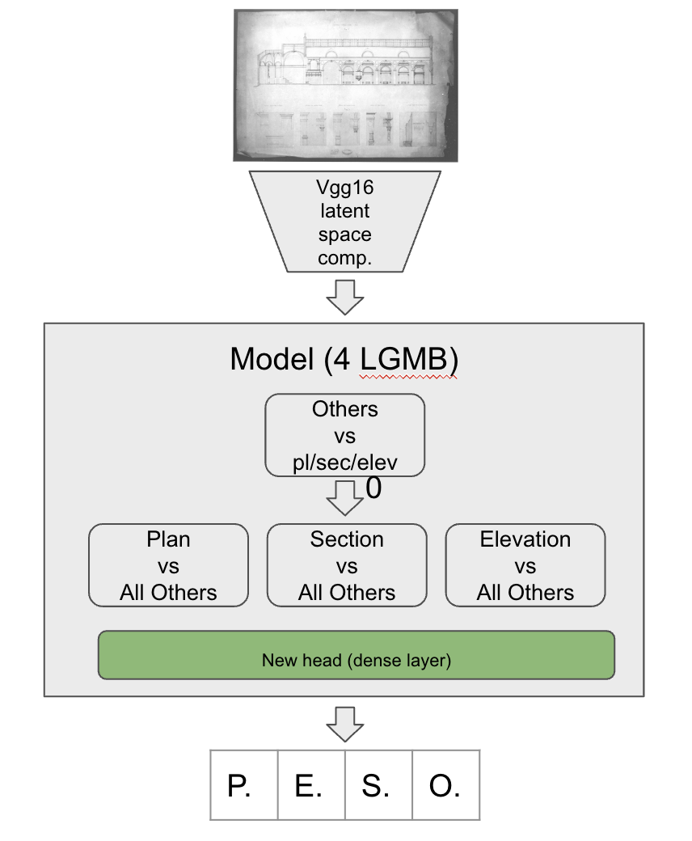
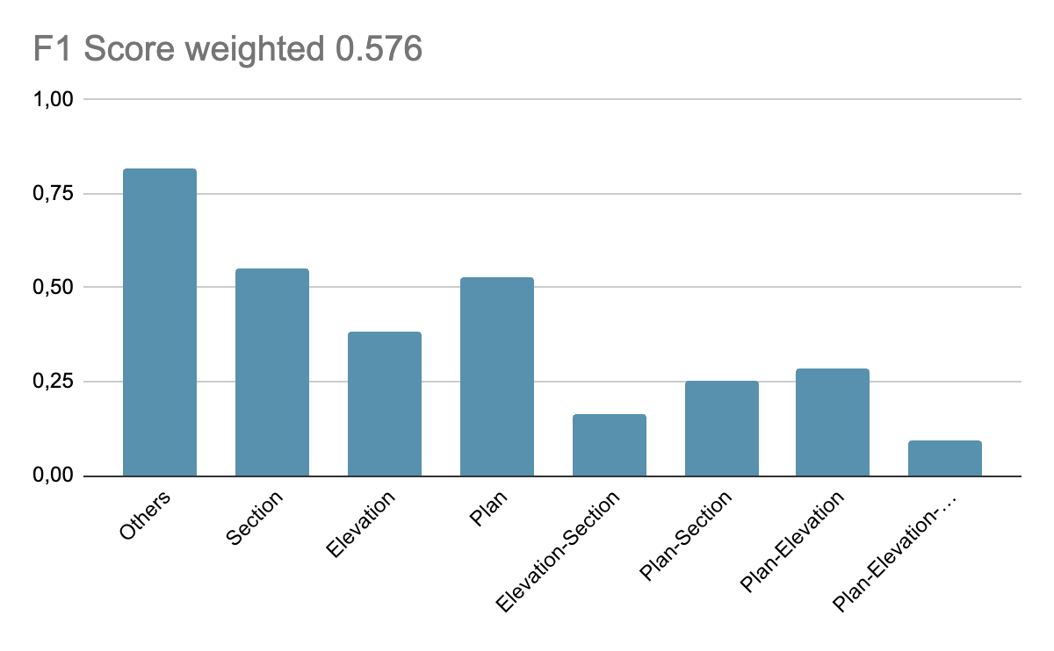
Use of new head (4 LGMB Cascade/binary classifiers)
precision recall f1-score support
['Others'] 0.836 0.800 0.818 441.000
['Section'] 0.592 0.515 0.551 169.000
['Elevation'] 0.444 0.339 0.385 118.000
['Elevation', 'Section'] 0.141 0.200 0.165 45.000
['Plan'] 0.561 0.502 0.530 201.000
['Plan', 'Section'] 0.226 0.286 0.252 49.000
['Plan', 'Elevation'] 0.286 0.282 0.284 78.000
['Plan', 'Elevation', 'Section'] 0.125 0.074 0.093 27.000
micro avg 0.594 0.557 0.575 1128.000
macro avg 0.214 0.200 0.205 1128.000
weighted avg 0.600 0.557 0.576 1128.000
Parallel 529 (46.9%) Cascade 509 (45.1%)
Tot errate 500 su 1128 (44.3%)

Slide 30
Use VGG16 new head
Vgg16 latent space comp.
Performance are not so good, next steps are:
new model
errors analysis
Model (new vgg16 head)
4096 Dense layer
4096 Dense layer
4 Dense layer
P as plan
E as elevation
S as Section
O as Other
P. | E. | S. | O.

Slide 31
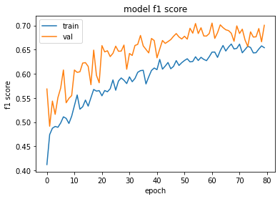
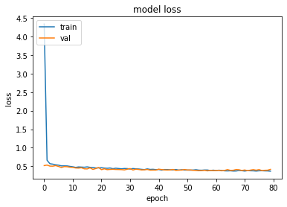
New neural network
Model: "NewHeadVGG16"
_________________________________________________________________
Layer (type) Output Shape Param #
=================================================================
input_5 (InputLayer) [(None, 224, 224, 3)] 0
vgg16 (Functional) (None, 7, 7, 512) 14714688
bottleneck (Flatten) (None, 25088) 0
dropout_3 (Dropout) (None, 25088) 0
dense_count_1 (Dense) (None, 4096) 102764544
activation_2 (Activation) (None, 4096) 0
dropout_4 (Dropout) (None, 4096) 0
dense_count_2 (Dense) (None, 4096) 16781312
activation_3 (Activation) (None, 4096) 0
dropout_5 (Dropout) (None, 4096) 0
dense_1 (Dense) (None, 4) 16388
=================================================================
Total params: 134,276,932
Trainable params: 119,562,244
Non-trainable params: 14,714,688
_________________________________________________________________

Slide 32
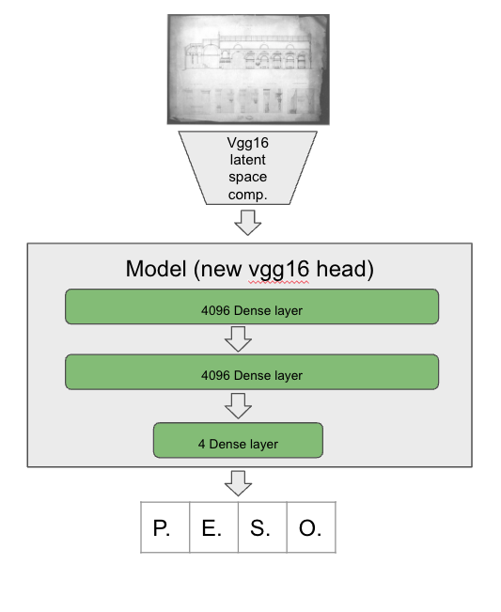
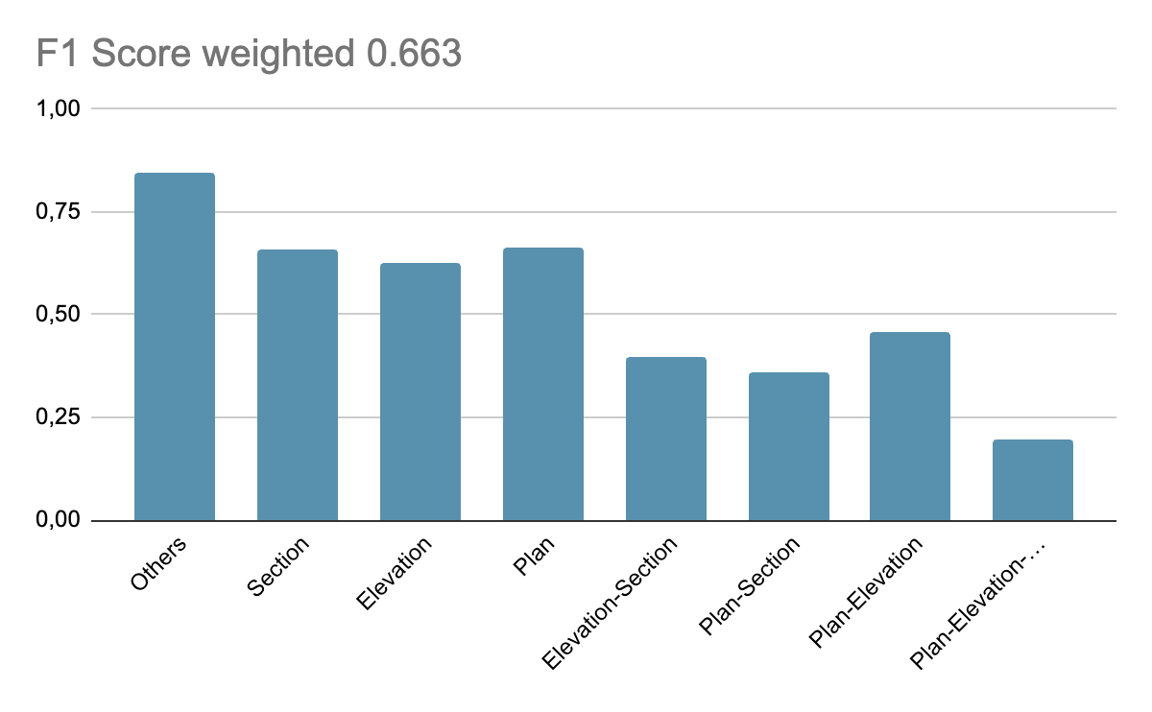
Use of VGG16 with new head
precision recall f1-score support
['Others'] 0.897 0.797 0.844 384.000
['Section'] 0.685 0.635 0.659 192.000
['Elevation'] 0.612 0.643 0.627 199.000
['Elevation', 'Section'] 0.329 0.500 0.397 54.000
['Plan'] 0.773 0.583 0.665 216.000
['Plan', 'Section'] 0.307 0.442 0.362 52.000
['Plan', 'Elevation'] 0.423 0.495 0.456 95.000
['Plan', 'Elevation', 'Section'] 0.145 0.308 0.198 26.000
micro avg 0.646 0.646 0.646 1218.000
macro avg 0.278 0.294 0.281 1218.000
weighted avg 0.692 0.646 0.663 1218.000
Parallel 529 (46.9%) Cascade 509 (45.1%)
N Head 500 (44.3%)
Tot errate 431 su 1218 (34.3%)

Slide 33
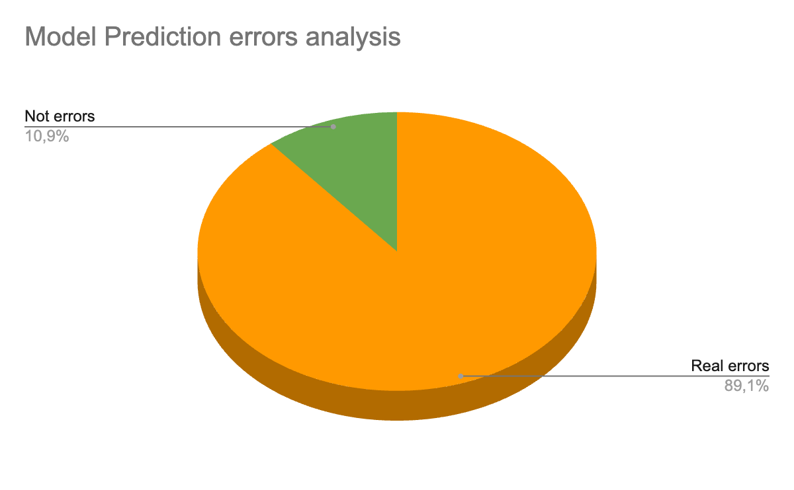
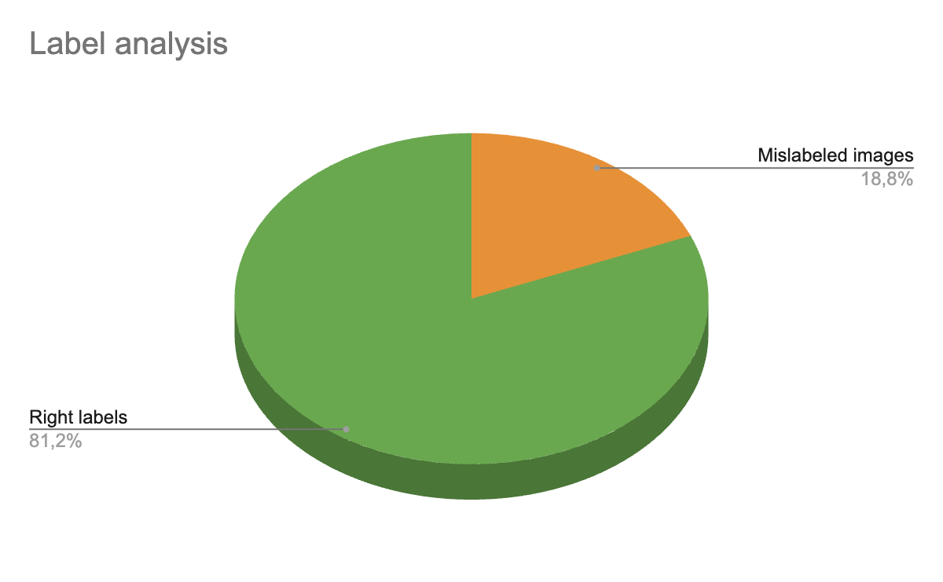
Test set error analysis (n.1)
Analysis of the model prediction on test set reveal possible labelling problems on dataset:

Slide 34
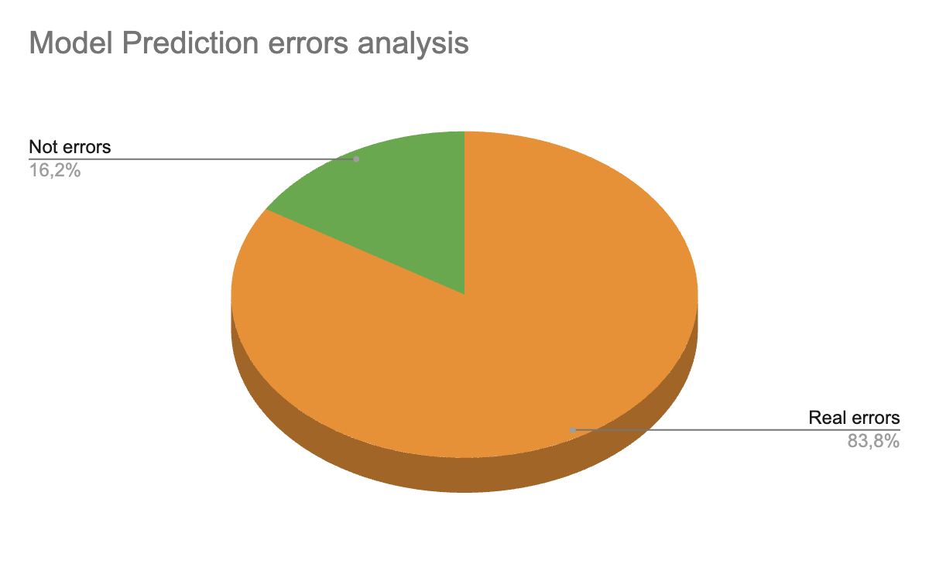
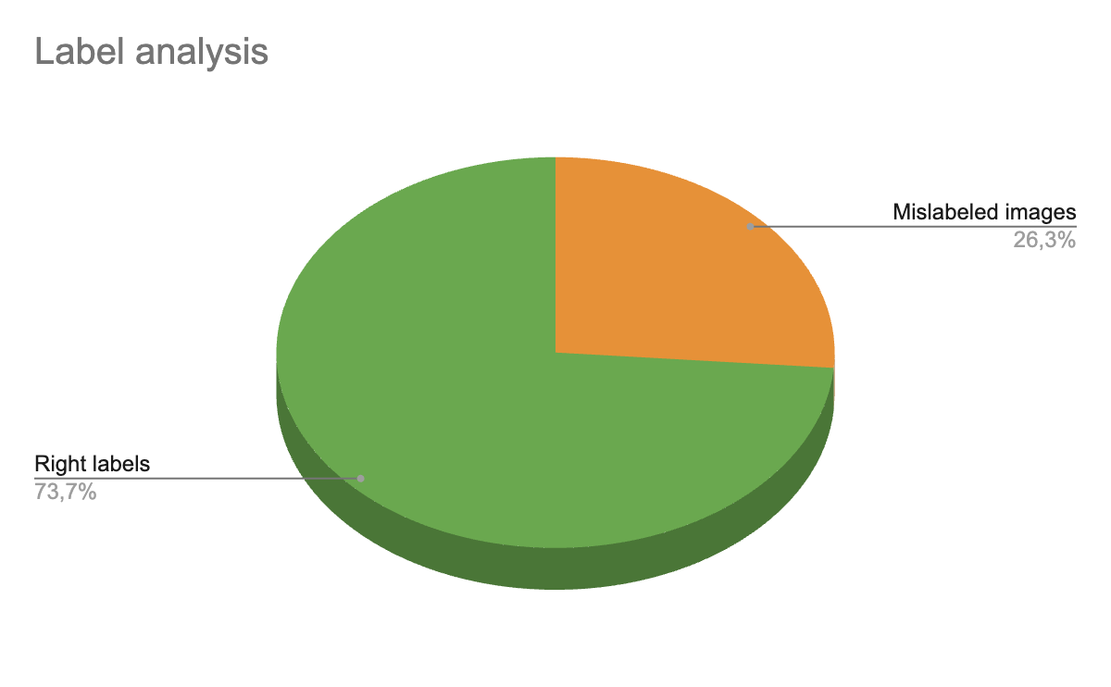
Training set error analysis (n.1)
Also the errors on training set has been analysed:
While errors on test set affect the model performance indicators, errors on training set affect the real model ability to deal with the problem.

Slide 35
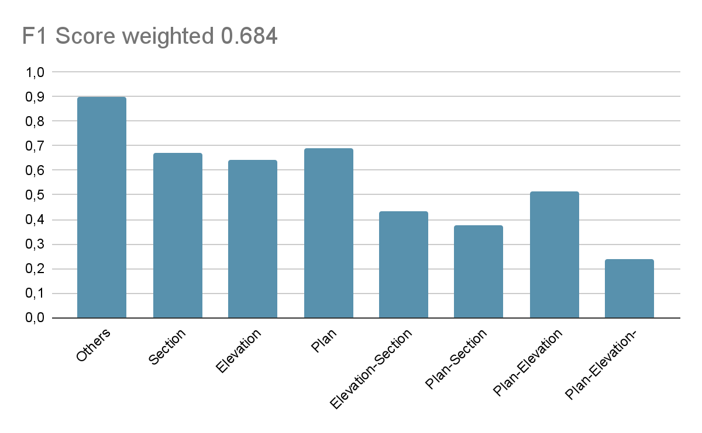
Dataset review (VGG new Head)
precision recall f1-score support
['Others'] 0.896 0.904 0.900 342.000
['Section'] 0.668 0.675 0.672 191.000
['Elevation'] 0.623 0.667 0.644 198.000
['Elevation', 'Section'] 0.431 0.438 0.434 64.000
['Plan'] 0.844 0.587 0.692 230.000
['Plan', 'Section'] 0.358 0.393 0.375 61.000
['Plan', 'Elevation'] 0.491 0.539 0.514 102.000
['Plan', 'Elevation', 'Section'] 0.177 0.367 0.239 30.000
micro avg 0.676 0.676 0.676 1218.000
macro avg 0.299 0.305 0.298 1218.000
weighted avg 0.703 0.676 0.684 1218.000
Parallel 529 (46.9%) Cascade 509 (45.1%)
N Head 500 (44.3%)
VGG16 h 431 (34.3%)
VGG16 h 395 (32.4%)

Slide 36


Test set error analysis (n.2)
The Analysis of the model prediction on test set reveal possible labelling problems on dataset (less compared to the previous analysis):

Slide 37


Training set error analysis (n.2)
Also the errors on training set has been analysed (less compared to the previous analysis):

Slide 38

Resume

Slide 39




Final Model - new data to augment data variance
Beni culturali 3489 files
Picryl 2924 files
Train - files 4876
Valid - files 489
Test - files 1046

Slide 40


Final Model
Training set data augmentation from 4876 to 8417

Slide 41

Final Model
Training setting 'Details' images set to Others class because potentially they could confuse the model.
Anywhere during test, 'Details' images remain in their original class.

Slide 42




Final Model - Training performance

Slide 43


Final Model - System usage during training

Slide 44




Final Model: Optimal Threshold for Precision-Recall Curve
Elevation
Best Threshold=0.468
F-Score=0.802
Plan -
Best Threshold=0.483
F-Score=0.797
The 4 output neurons has a threshold transforming decimal values to boolean. Each threshold has a standard value of 0.5 but needs to be optimized on training set.
Section
Best Threshold=0.531
F-Score=0.706
Others
Best Threshold=0.371
F-Score=0.910

Slide 45




Final Model - Thresholds vs Test set
Binary F1 score gain
to 0.778
from 0.769

Slide 46


Final Model performance on test set
Parallel 529 (46.9%) Cascade 509 (45.1%)
N Head 500 (44.3%)
VGG16 h 431 (34.3%)
VGG16 h 395 (32.4%)
VGG16 h 336 (31.0%)

Slide 47


Final Model - Performance details over Test set
Test single class: Plan
One vs Others on validation set
Classification Report
precision recall f1-score support
˜All Others˜ 0.90 0.89 0.90 723
Plan 0.77 0.78 0.77 323
accuracy 0.86 1046
macro avg 0.83 0.84 0.84 1046
weighted avg 0.86 0.86 0.86 1046
Test single class: Elevation
One vs Others on validation set
Classification Report
precision recall f1-score support
˜All Others˜ 0.89 0.87 0.88 709
Elevation 0.74 0.77 0.75 337
accuracy 0.84 1046
macro avg 0.81 0.82 0.81 1046
weighted avg 0.84 0.84 0.84 1046

Slide 48


Final Model - Performance details over Test set
Test single class: Section
One vs Others on validation set
Classification Report
precision recall f1-score support
˜All Others˜ 0.90 0.86 0.88 779
Section 0.65 0.73 0.69 267
accuracy 0.83 1046
macro avg 0.78 0.80 0.79 1046
weighted avg 0.84 0.83 0.83 1046
Test single class: Others
One vs Others on validation set
Classification Report
precision recall f1-score support
˜All Others˜ 0.93 0.97 0.95 708
Others 0.94 0.85 0.89 338
accuracy 0.93 1046
macro avg 0.93 0.91 0.92 1046
weighted avg 0.93 0.93 0.93 1046

Slide 49

Deliverables
GitHub source to train and run models
Repository DB e annotazioni
Web service and Web App to run the service
Docker Container
WebApp
Flask
jinja2
Bootstrap
Model

Slide 50


Web application

Slide 51


Web application

Slide 52
Thank you
Fabio D’Amore
fabio.damore@istc.cnr.it

